Slide 1
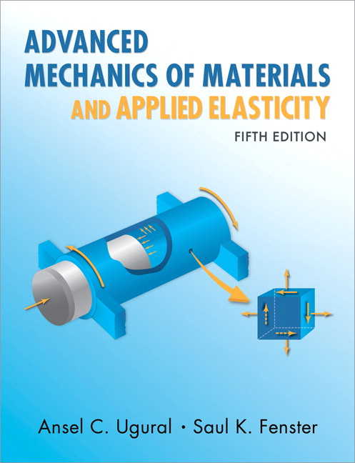
Advanced Mechanics
(Lecture 3)
ANNOUNCE / BUSINESS
HW 1 (due Th, 1/16)
HW 2 (due Th, 1/23)
NEW STUFF
Questions?
General overview of problem solving
Mohr’s circle
3-D stress
Examples

Slide 2
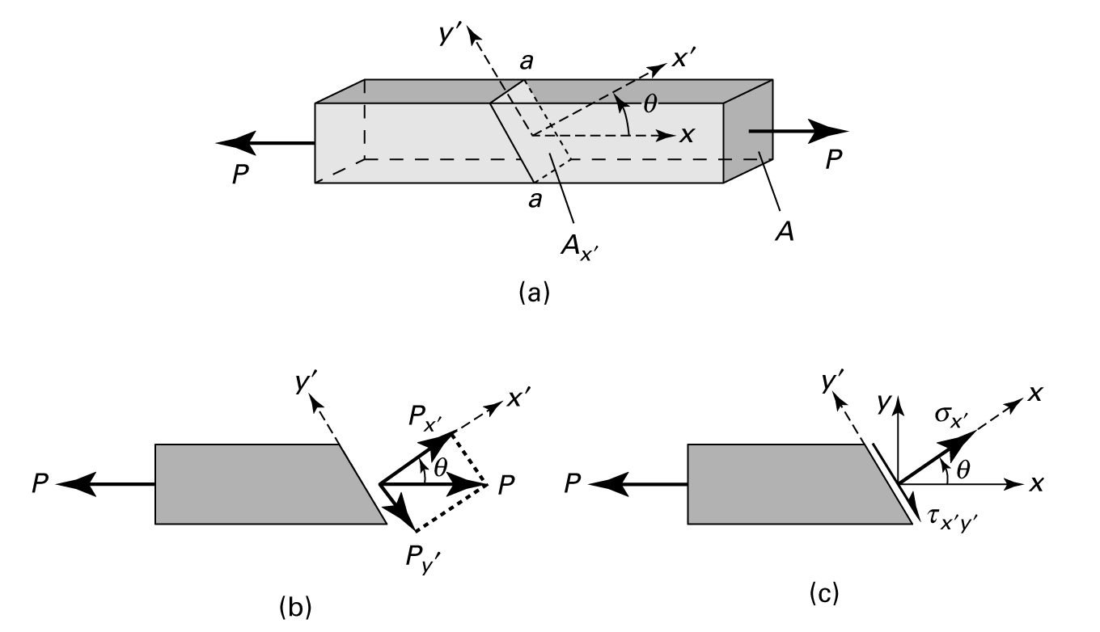


Stress on Inclined Sections
Note
stress components change with coordinate system even though loading does not change
results are achieved by force equilibrium, not stress equilibrium (no such law)
Notes:
Demonstrates that stress components change as we change the coord sys they refer to

Slide 3
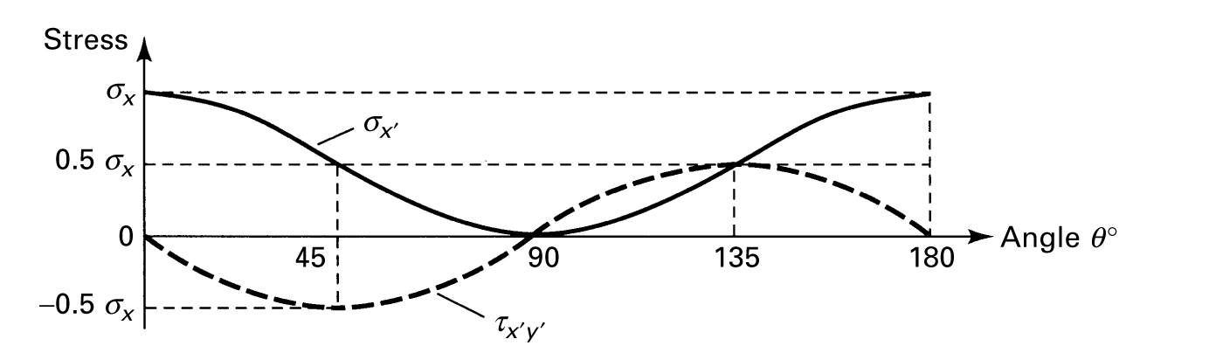
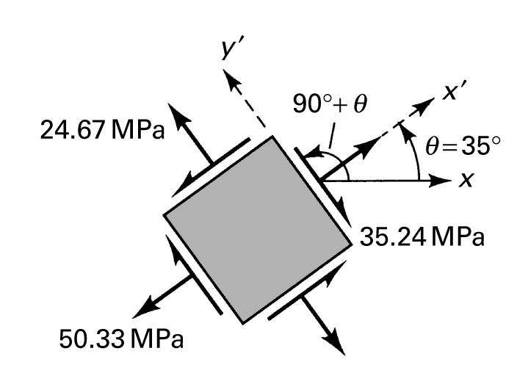
Stress on Inclined Sections
Prelude to stress transformation

Slide 4
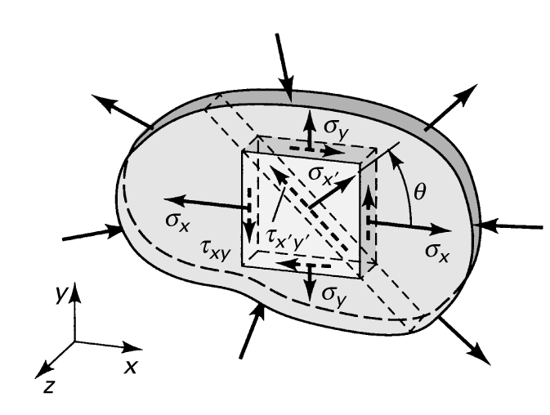
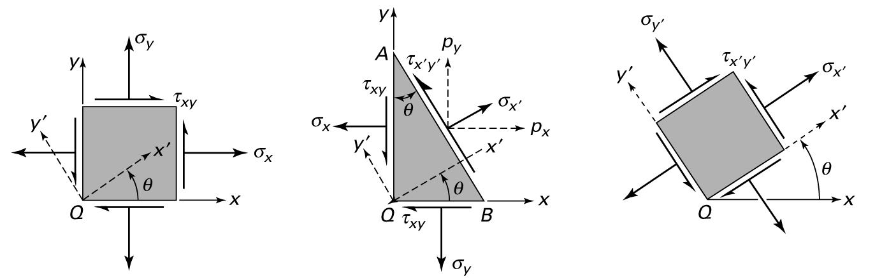
Stress Transformation – Plane Stress

Slide 5


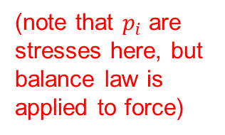
Stress Transformation – Plane Stress
(note that $p_{i}$ are stresses here, but balance law is applied to force)
Remember: Stress does not change during transformation, but its components change in the different coordinate system
Notes:
p, sigma, and tau are all stresses here, but equilibrium requires equality of force, so areas are also considered; hence, the first set of equations between p and sig and tau
These are the equations that define Mohr’s Circle

Slide 6
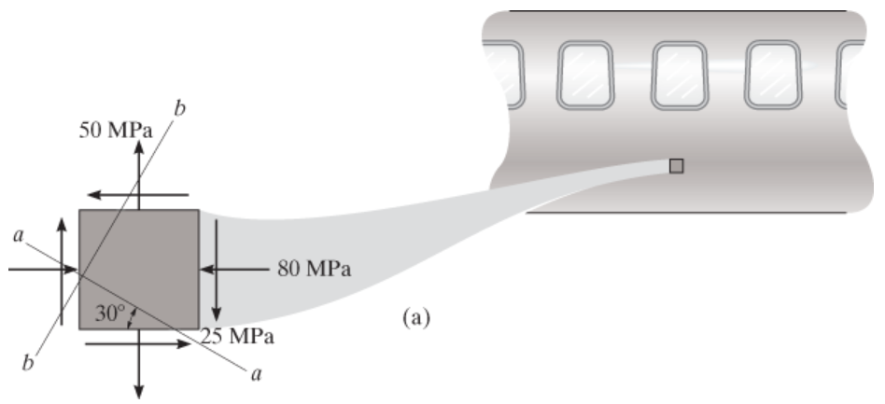
Mohr’s Circle
Alternative to memorizing long equations … Mohr’s Circle
Example: The state of plane stress at a point on the surface of the airplane fuselage is represented on the element oriented as shown. (a) Represent the state of stress at the same point on an element that is oriented 30° clockwise from this position. Also find (b) the principal stresses and (c) the max shear stress.
Notes:
My conventions for Mohr’s Circle:
Shear stress axis positive downward – preserves rotation direction (CCW still positive)
Sign of shear stress in stress state is defined by considering direction of rotation stress causes on element, again using right hand rule

Slide 8
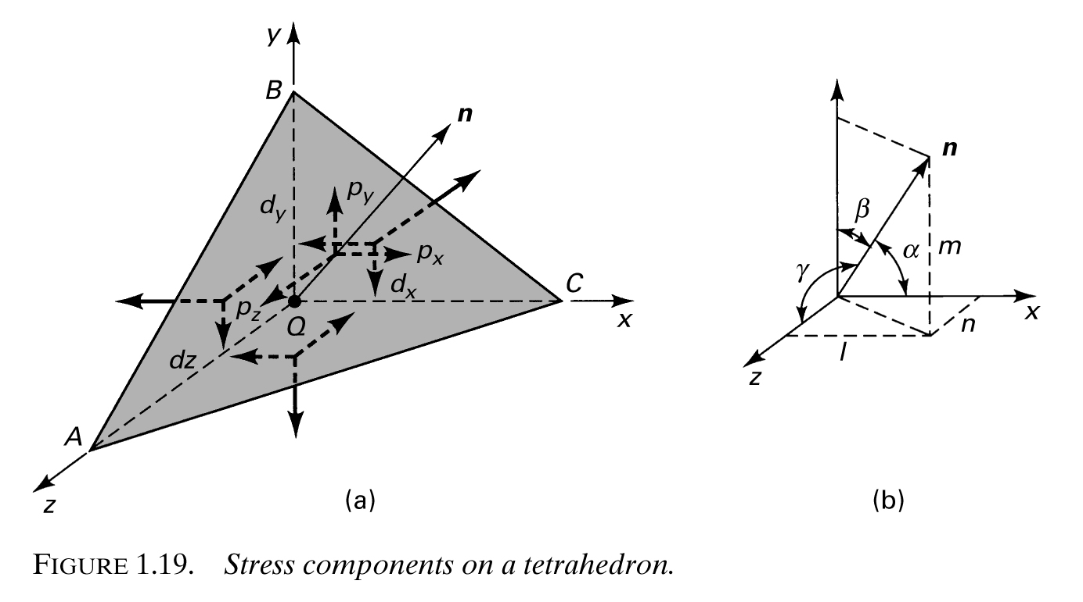
Stress Transformation – 3-D
Enforce equilibrium on tetrahedron with angled surface having normal n

Slide 9



Stress Transformation – 3-D

Slide 10


y
Direction Cosines

Slide 11
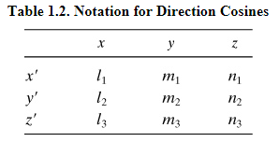
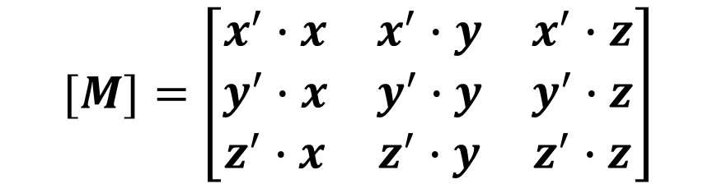




y
Direction Cosines
$$=x′$$
$$1$$
$$1$$
$$1$$
$$[M]=\left[\begin{matrix}x^{′}∙x & x^{′}∙y & x^{′}∙z \\ y^{′}∙x & y^{′}∙y & y^{′}∙z \\ z^{′}∙x & z^{′}∙y & z^{′}∙z\end{matrix}\right]$$

Slide 12
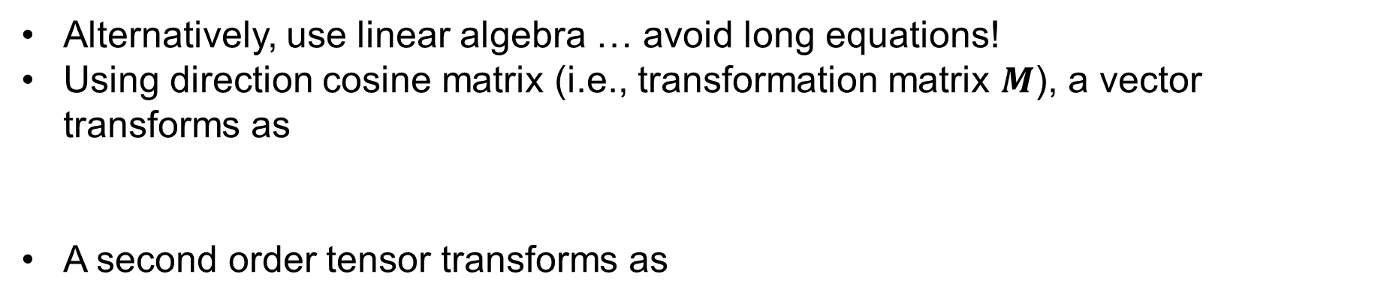
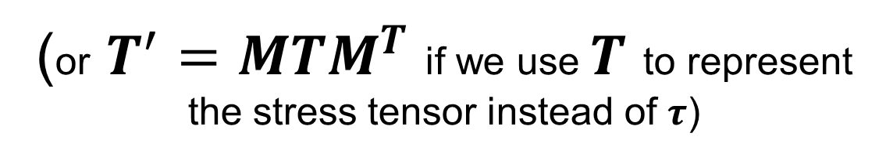


Linear Algebra Approach
Alternatively, use linear algebra … avoid long equations!
Using direction cosine matrix (i.e., transformation matrix $M$), a vector transforms as
A second order tensor transforms as
$$a^{′}=Ma$$
$$τ^{′}=MτM^{T}$$
(or $T^{′}=MTM^{T}$ if we use $T$ to represent the stress tensor instead of $τ$)
* Note that Eqn’s 1.29 in the text have incorrectly switched the transform order

Slide 13





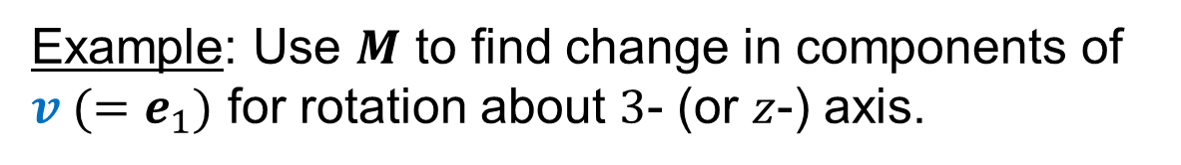


$$e_{2}^{′}$$
$$e_{2}$$
Example: Use $M$ to find change in components of $v (=e_{1})$ for rotation about $3$- (or $z$-) axis.
$$e_{1}^{′}$$
$$θ$$
$$e_{1}$$
$$v$$
$${e_{3}, e}_{3}^{′}$$

Slide 14








Example: Now do the same for the stress associated with uniaxial tension.
$$e_{2}^{′}$$
$$e_{2}$$
$$e_{1}^{′}$$
$$θ$$
$$e_{1}$$
$${e_{3}, e}_{3}^{′}$$
$$σ$$
$$σ$$
Stress transformation is simplest using linear algebra.

Slide 15
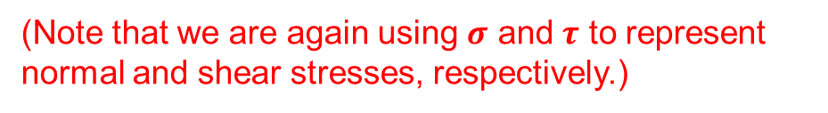

Principal Stress – Stress on Arbitrary Plane
The traction, or stress, vector t gives the magnitude and direction of force per unit area acting on any surface.
(Note that we are again using $σ$ and $τ$ to represent normal and shear stresses, respectively.)
t, traction vector
σ, normal stress
cutting plane
$$t=Tn=σ+τ$$
τ,
shear stress
n, surface unit
normal vector

Slide 16



Principal Stresses
Determine the particular surface normal n that maximizes the normal stress $$ and zeros the shear stress $τ$. In this case,
That is, we seek a coordinate system in which the stress tensor is diagonalized
Note that this is just one surface of 3
$$t=σ$$
cutting plane
$$t=Tn=σ+τ=σn$$
n, surface unit
normal vector

Slide 17


Principal Stresses – Eigenvalue Problem
To determine the special directions that correspond to the maximum normal stresses, we need to solve the eigenvalue problem:
$$Tn=σn$$
$$Tn−σn=0=\left(T−σ1\right)n$$

Slide 18

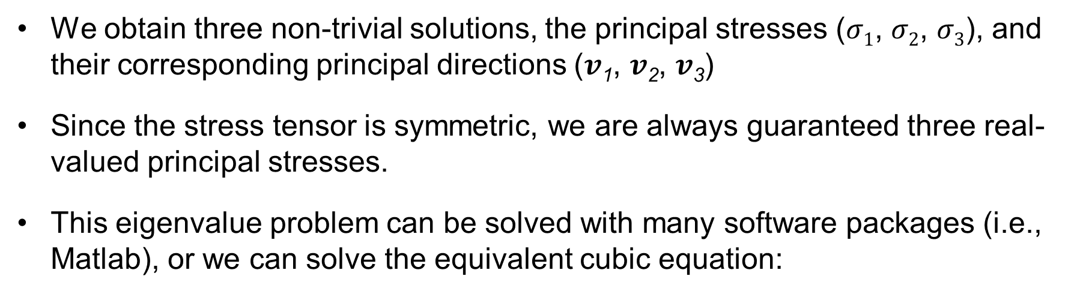
Eigenvalue Problem
$\left(T−σ1\right)v=0$ (replacing $n$ with $v$)
We obtain three non-trivial solutions, the principal stresses ($σ1$, $σ2$, $σ3$), and their corresponding principal directions ($v$₁, $v$₂, $v$₃)
Since the stress tensor is symmetric, we are always guaranteed three real-valued principal stresses.
This eigenvalue problem can be solved with many software packages (i.e., Matlab), or we can solve the equivalent cubic equation:
$$\det\left(T−σ1\right)=0$$
* It is fine to use Matlab or any other computational tool to solve this and other linear algebra problems required for homework.

Slide 19
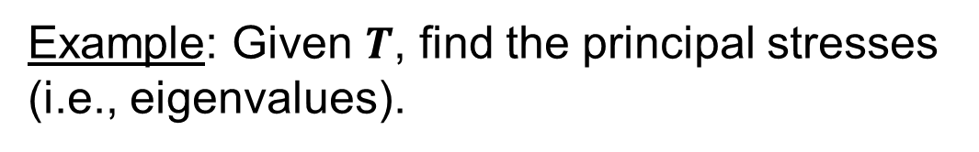
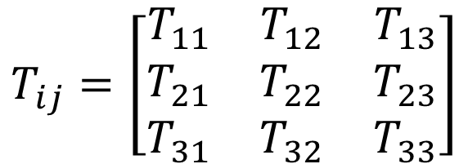

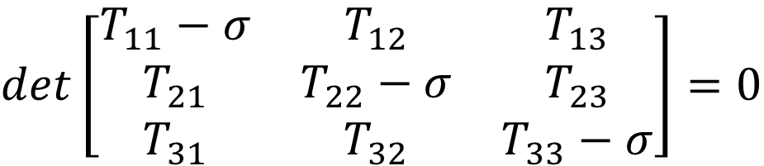
Eigenvalue Problem
Example: Given $T$, find the principal stresses (i.e., eigenvalues).
$$T_{ij}=\left[\begin{matrix}T_{11} & T_{12} & T_{13} \\ T_{21} & T_{22} & T_{23} \\ T_{31} & T_{32} & T_{33}\end{matrix}\right]$$
$$\det\left(T−σ1\right)=0$$
$$det\left[\begin{matrix}T_{11}−σ & T_{12} & T_{13} \\ T_{21} & T_{22}−σ & T_{23} \\ T_{31} & T_{32} & T_{33}−σ\end{matrix}\right]=0$$
$$σ^{3}−\left(T_{11}+T_{22}+T_{33}\right)σ^{2}+\left(T_{11}T_{22}+T_{22}T_{33}+T_{33}T_{11}−T_{12}^{2}−T_{13}^{2}−T_{23}^{2}\right)σ−\left(T_{11}T_{22}T_{33}−T_{11}T_{23}^{2}−T_{22}T_{13}^{2}−T_{33}T_{12}^{2}+2T_{12}T_{13}T_{23}\right)=0$$

Slide 20

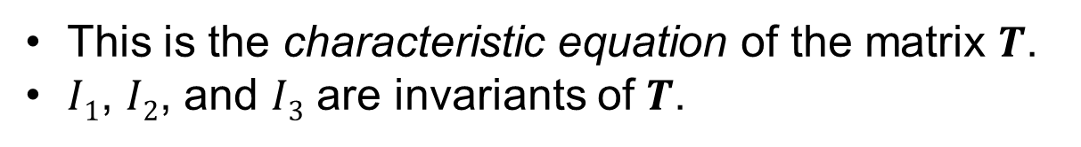



Characteristic Equation
$$I1$$
$$I2$$
$$σ^{3}−\left(T_{11}+T_{22}+T_{33}\right)σ^{2}+\left(T_{11}T_{22}+T_{22}T_{33}+T_{33}T_{11}−T_{12}^{2}−T_{13}^{2}−T_{23}^{2}\right)σ−\left(T_{11}T_{22}T_{33}−T_{11}T_{23}^{2}−T_{22}T_{13}^{2}−T_{33}T_{12}^{2}+2T_{12}T_{13}T_{23}\right)=0$$
$$I3$$
$$σ^{3}−I_{1}σ^{2}+I_{2}σ−I_{3}=0$$
This is the characteristic equation of the matrix $T$.
$I1$, $I2$, and $I3$ are invariants of $T$.

Slide 21
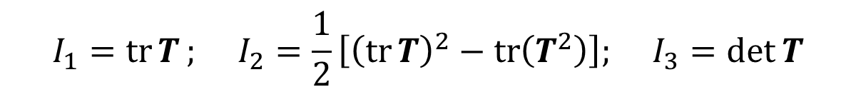
Invariants of the Stress Tensor
The three principal stresses are intrinsic to the stress tensor.
They are invariant, meaning independent of the coordinate system used to define the stress tensor.
Can also express invariants using linear algebra:
$$I_{1}=\operatorname{tr}{T}; I_{2}=\frac{1}{2}\left[{\left(\operatorname{tr}{T}\right)}^{2}−\operatorname{tr}\left(T^{2}\right)\right]; I_{3}=\det{T}$$

Slide 22
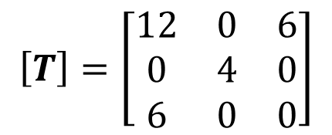
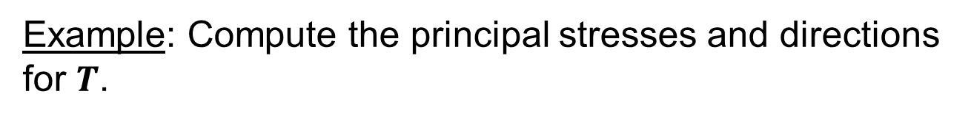

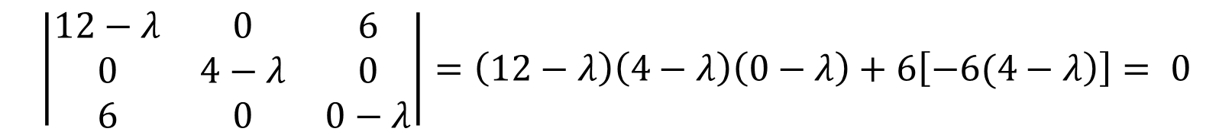
Principal Stresses
Example: Compute the principal stresses and directions for $T$.
$$\left[T\right]=\left[\begin{matrix}12 & 0 & 6 \\ 0 & 4 & 0 \\ 6 & 0 & 0\end{matrix}\right]$$
$$\left|\begin{matrix}12−λ & 0 & 6 \\ 0 & 4−λ & 0 \\ 6 & 0 & 0−λ\end{matrix}\right|=\left(12−λ\right)\left(4−λ\right)\left(0−λ\right)+6\left[\left.−6(4−λ\right)\right]= 0$$
*Note we’re now using $λ$ instead of $σ$!
Solving polynomial → λ₁ = 14.5; λ₂ = 4.0; λ₃ = -2.5 (principal stresses)

Slide 23




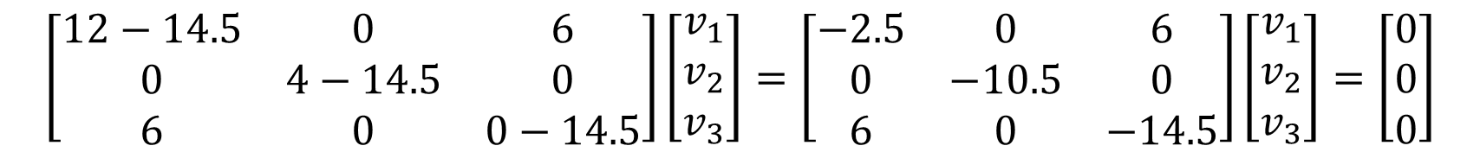

Now find the eigenvectors …
by plugging each eigenvalue back into the equation and solving for the associated vector.
$$Tv=λv → \left(T−Iλ\right)v=0$$
For $λ1 = 14.5$,
$$\left[\begin{matrix}12−14.5 & 0 & 6 \\ 0 & 4−14.5 & 0 \\ 6 & 0 & 0−14.5\end{matrix}\right]\left[\begin{matrix}v_{1} \\ v_{2} \\ v_{3}\end{matrix}\right]=\left[\begin{matrix}−2.5 & 0 & 6 \\ 0 & −10.5 & 0 \\ 6 & 0 & −14.5\end{matrix}\right]\left[\begin{matrix}v_{1} \\ v_{2} \\ v_{3}\end{matrix}\right]=\left[\begin{matrix}0 \\ 0 \\ 0\end{matrix}\right]$$
$$−{2.5v}_{1}+6v_{3}=0 → v_{1}=2.4v_{3}$$
$${−10.5v}_{2}=0 → v_{2}=0$$
$$6v_{1}−14.5v_{3}=0 → v_{1}={2.4v}_{3}$$

Slide 24




$$−{2.5v}_{1}+6v_{3}=0 → v_{1}=2.4v_{3}$$
$${−10.5v}_{2}=0 → v_{2}=0$$
$$6v_{1}−14.5v_{3}=0 → v_{1}={2.4v}_{3}$$
$$\left[\begin{matrix}v_{1} \\ v_{2} \\ v_{3}\end{matrix}\right]=\left[\begin{matrix}2.4 \\ 0 \\ 1\end{matrix}\right] ⇒ \hat{v}=\frac{1}{\sqrt{6.76}}\left[\begin{matrix}2.4 \\ 0 \\ 1\end{matrix}\right]$$
(unit vector)
We now have the eigenvector for the first principal stress … need to repeat to find other two.
Note that our results satisfy the original equation $t=Tn=σn$ where $σ=\text{l}\text{1}$ and $n=\hat{v}$.
** Note that $\hat{v}$ here is the first row of the transformation matrix $M$ that transforms $T$ into the coordinate system corresponding to its principal stresses (so here, ${\hat{v}}_{1}=l_{1}$,${\hat{v}}_{2}=m_{1}$,${\hat{v}}_{3}=n_{1}$, the direction cosines!)

Slide 25

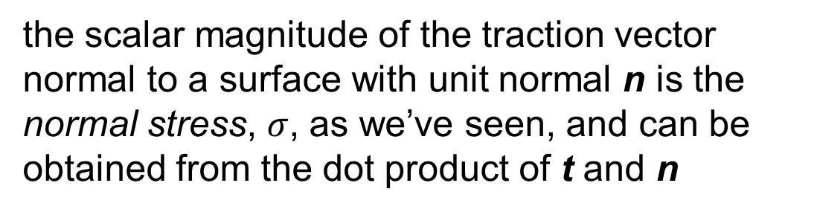

Stresses on an Arbitrary Plane
Recalling our relationships for the traction vector,
t, traction vector
$$t=Tn=σ+τ$$
σ, normal stress
the scalar magnitude of the traction vector normal to a surface with unit normal n is the normal stress, $σ$, as we’ve seen, and can be obtained from the dot product of t and n
cutting plane
τ,
shear stress
n, surface unit
normal vector
$$σ=t∙n$$
Notes:
Recall notes on stresses on inclined plane in Lecture 3

Slide 26
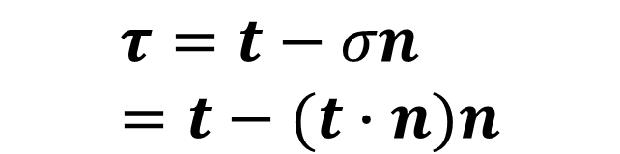
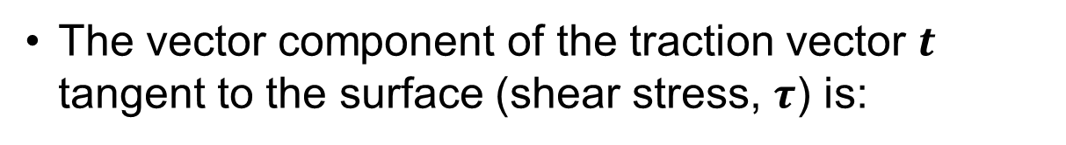
Stresses on an Arbitrary Plane
The vector component of the traction vector $t$ tangent to the surface (shear stress, $τ$) is:
t, traction vector
σ, normal stress
cutting plane
$$τ=t−σn=t−(t∙n)n$$
τ,
shear stress
n, surface unit
normal vector
*As with stress transformation, the book provides equations to calculate values for normal and shear stress on an arbitrary surface, but the linear algebra approach is much simpler to remember.

Slide 27
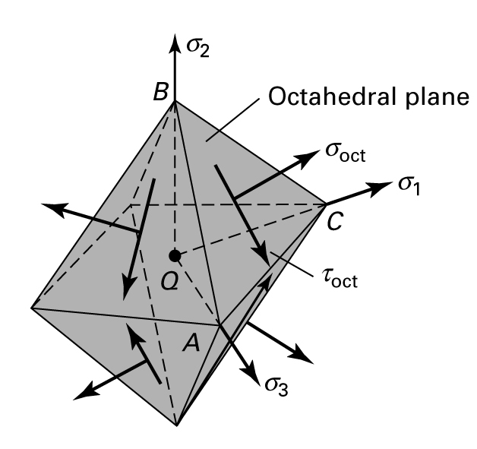
Stresses on a Plane – Octahedral Stress
Octahedral stress: The octahedral plane is that where the three components of the surface normal are equal, i.e., the three direction cosines are equal (relative to the principal stress axes).
This stress is relevant to some failure criteria.

Slide 28
Mohr’s Circle – 3D
Mohr’s Circle still applies in 3-D; three circles instead of one; consider example we started the day with
Example: Given stress state shown, use Mohr’s Circle to find (a) the principal stresses and (b) the max shear stress.
y
40
(all MPa)
40
20
100
x
z

Slide 29
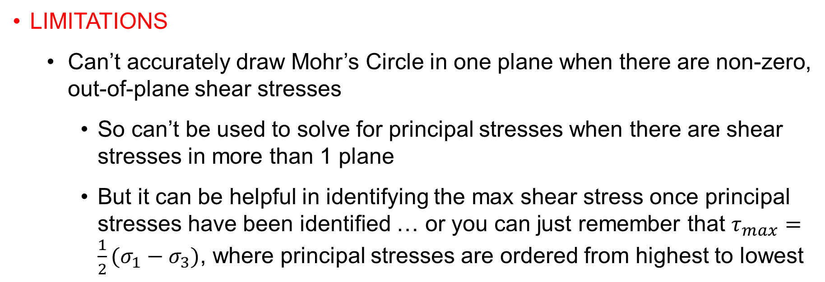
Mohr’s Circle – 3D
Limitations
Can’t accurately draw Mohr’s Circle in one plane when there are non-zero, out-of-plane shear stresses
So can’t be used to solve for principal stresses when there are shear stresses in more than 1 plane
But it can be helpful in identifying the max shear stress once principal stresses have been identified … or you can just remember that $τ_{max}=\frac{1}{2}(σ_{1}−σ_{3})$, where principal stresses are ordered from highest to lowest

Slide 30
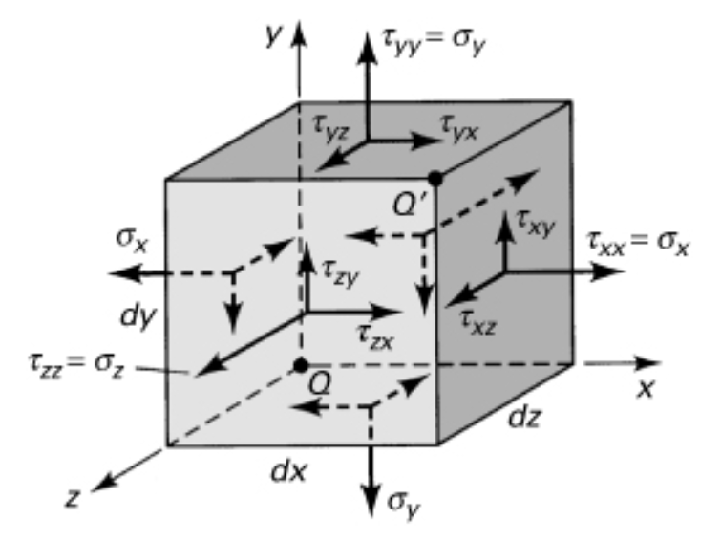
Recap of 3-D stress topics
Stress transformation
Principal stresses
Stresses on arbitrary surface

Slide 31
Mohr’s Circle – 3D
Limitations
Can’t accurately draw Mohr’s Circle in one plane when there are non-zero, out-of-plane shear stresses
So can’t be used to solve for principal stresses when there are shear stresses in more than 1 plane
But it can be helpful in identifying the max shear stress once principal stresses have been identified … or you can just remember that $τ_{max}=\frac{1}{2}(σ_{1}−σ_{3})$, where principal stresses are ordered from highest to lowest

Slide 32
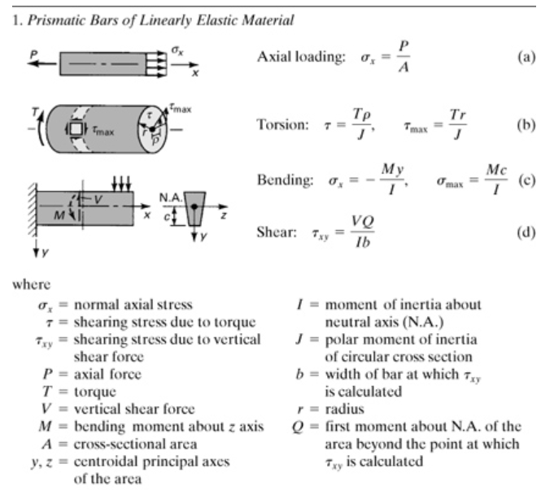
Mechanics of Structures (Table 1.1 of Text)

Slide 33
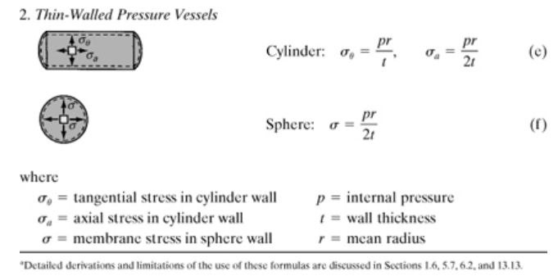
Mechanics of Structures (Table 1.1 of Text)

